Slide 1
Medication Assisted Treatment
Daniel T. Brown, D.O.
Medical Director, Meridian HealthCare

Slide 2
Objectives
Enhance understanding of:
History of Opiate Addiction
Physiology of Opiate Addiction
Evidence in Support of MAT
Medications used in Medication Assisted Treatment:
Methadone
Buprenorphine
Naltrexone
Naloxone

Slide 5
Early Treatment Attempts
By 1900, some physicians were attempting to treat opiate addicts with tapering doses of morphine or heroin.
By 1914 it was estimated that one in 400 Americans were addicted to opiates.
New York Department of Health established a clinic to treat opiate addicts with weaning doses.
1919 All early attempts at MAT ended by due to Harrison Act.
1935 “The Narcotic Farm” (97% relapse rates)
1960’s Civil Commitment (5 out of 6 relapsed)

Slide 6
Beginning of Medication Assisted Treatment
1950’s to 1970’s, prisons overcrowded with drug abusers, crime rates were high and overdose deaths were rising.
AMA and American Bar Association joint proposal for the formation of OTPs (1958)
By 1965 first methadone programs were started as research.
Initial programs showed great response in retention in treatment, reduction in crime and reduction in drug use.
By 1970 the Nixon administration greatly increased funding to expand Opioid Treatment Programs.

Slide 7
Neurophysiology of Opioid Dependence
The Locus Ceruleus produces Noradrenaline which stimulates wakefulness, breathing, blood pressure, general alertness and other functions.
Opiates link to Mu receptors in the LC and suppress the release of NA resulting in drowsiness, slowed respirations, low BP, etc.
LC neurons chronically exposed to opiates adapt and produce normal levels of NA even when opiates are present.
In the absence of opiates these neurons release excessive amounts of NA resulting in withdrawal symptoms (anxiety, muscle cramps, diarrhea, restlessness).

Slide 8
Neurophysiology of Opioid Addiction
Stimulation of Mesolimbic (Midbrain) Reward System.
Signals Ventral Tegmental Area (VTA) which causes release of Dopamine (DA) into the Nucleus Accumbens resulting in euphoria.
Form associations linking euphoria to persons, places, smells, sounds, etc.
Cravings are stimulated by these associations.

Slide 9
Why are we treating Opioid Addiction with Opioids?!
Why don’t we treat Alcohol Use Disorders with Alcohol? Cocaine? Benzodiazepines?
Important to understand unique aspects of Opioid Addiction.
Lethality of Disease
Severity and length of Acute withdrawal symptoms
Protracted Post-Acute withdrawal syndrome with cravings lasting > 1 year
Highest rates of relapse
Association with Criminal Activity
Association with transmission of Infectious Disease

Slide 10
Important Concepts for Understanding MAT
Addiction vs. Dependence – Absence of harm and the pathological pursuit of the substance
Medical Futility
Risk vs. Benefit
NO Punitive role for Addiction Medicine Providers
Treatment based on best available medical evidence. Must not treat based on personal beliefs!

Slide 11
Benefits of MAT
Decreased risk of Hepatitis C, HIV transmission
Decreased criminal activity as well as risk of becoming a victim of violent crime.
For Pregnant patients, decreased risk of low birth weight, premature birth and obstetric complications.
Improves retention in treatment and decreases relapse rates.
Decreased risk of death (all causes) 15X !!!!

Slide 12
Methadone
Synthetic Opioid developed in Germany in 1937
Full Agonist of Mu receptor
Mean elimination half-life 22hours
First used in MAT in 1960’s
Used in liquid form (10mg/1ml) for MAT

Slide 13
Methadone Disadvantages
High variability in elimination half-life
Tolerance with chronic use
Side effects of weight gain, apathy
Prolongation of QT interval at higher doses
Many drug interactions
Intoxication/impairment at higher plasma levels

Slide 14
Methadone Advantages
Daily dosing required
Improved retention in treatment
Less Diversion
Easily adjusted dose (1mg increments)
Cost

Slide 16
Buprenorphine
Developed to be a less habit-forming opioid by Reckitt & Colman
Initially released in injection form in 1978 for acute pain in ER setting. Only used in Europe.
Sublingual form developed in 1982
FDA approved in 2002 for treatment of opioid dependence
Initially physicians were only allowed to treat 10 patients. 2006 increased to 100 patients.

Slide 17
Buprenorphine
Partial Agonist of Mu receptor
Mean elimination half-life of 37 hours
Available in several forms
Suboxone films (buprenorphine/naloxone) 8mg/2mg and 2mg/0.5mg
Suboxone sublingual tablets
Subutex (buprenorphine) 8mg/2mg
Zubsolv sublingual tablets 5.7/1.4mg and 1.4/0.36
Bunavail buccal films 2.1/0.3, 4.2/0.7, 6.3/1mg

Slide 18
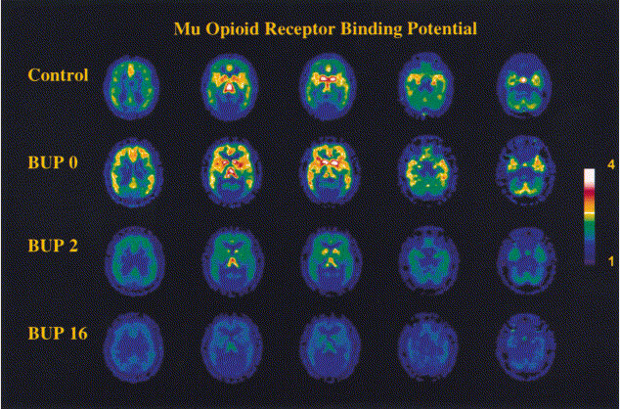

Slide 19
Buprenorphine Disadvantages
Must wait until patient is in full withdrawal or risk precipitated withdrawal.
Potential for Hepatic Dysfunction
Side effect of nausea in some patients
Dosing adjustments are limited in tablet form
Expensive
Limited to 100 patients per physician license
Lack of long-term data on infant and child effects.
Clinically significant increase in drop-out rates compared to Methadone.
Increased Risk of Diversion

Slide 20
Buprenorphine Advantages
Partial Agonist with “ceiling effect” and lower risk of overdose.
Less Tolerance.
Fewer Drug Interactions.
When combined with naloxone, IV abuse is deterred.
“Functional Antagonist” due to high affinity for Mu receptor.
Patients are eligible for “take-home” dosing on day one of treatment, which allows for split dosing without daily visits.
Evidence of Less Severe NAS

Slide 21
Neonatal Abstinence Syndrome
“neonatal syndrome is an expected and treatable condition that follow prenatal exposure to opioid agonists…” (Joint Committee Opinion of ACOG and ASAM)
Methadone exposed infants may begin withdrawal symptoms anytime in the first 2 weeks of life but usually appear by 72 hours.
Buprenorphine exposed infants generally develop symptoms within 12-48 hours, peak at 72-96 hours and resolve by 7 days.
No evidence of correlation between severity of NAS and dose of methadone.

Slide 22
How do we choose the appropriate MAT Medication for our patients?
All patients should be initially treated with buprenorphine unless:
Previous treatment failure with buprenorphine
Unstable environment with high risk of diversion
Currently on Methadone

Slide 23
Naltrexone Therapy:
Oral Tablet:
25-50mg daily – usually lasts 24-48 hrs
First discovered in 1963; FDA approved in 1984 to treat opioid dependence.
Vivitrol Injection:
Once-monthly 380mg IM injection
FDA approved in 2010 for opioid dependence

Slide 24
Naltrexone Therapy
Advantages:
Prevents relapse by blocking access to Mu Receptor
Substantially reduces cravings
Not addictive
No withdrawal symptoms
Very few side effects

Slide 25
Naltrexone Therapy
Disadvantages:
Poor retention in treatment
Patients must detox before treatment
Opioid free 7-10 days minimum
Methadone and Suboxone 14 days
Patients who relapse after Naltrexone therapy have lower tolerance and may be at increased risk of overdose.

Slide 27
Why am I willing to prescribe MAT for long periods of time?
Evidence Based Medicine supports a minimum of 18 months of treatment to achieve desired outcomes.
Patients who are participating in programs, invested in their recovery and stable on a dose of buprenorphine have NO risk to reward benefit from stopping MAT.
Patients who are forced to taper from buprenorphine have increased risk of relapse and therefore increase risk of death.
Name one other instance where physicians stop prescribing an effective medication and cause an increase in their patient’s mortality rate.

Slide 28
