Slide 1
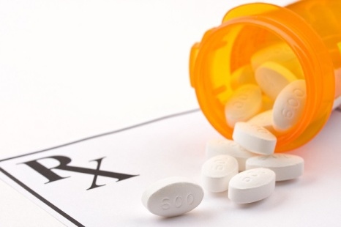
Medication-Assisted Therapy at Coleman Profession Services
Brian C. Welsh, MD
Chief Medical Officer
Coleman Professional Services

Slide 2
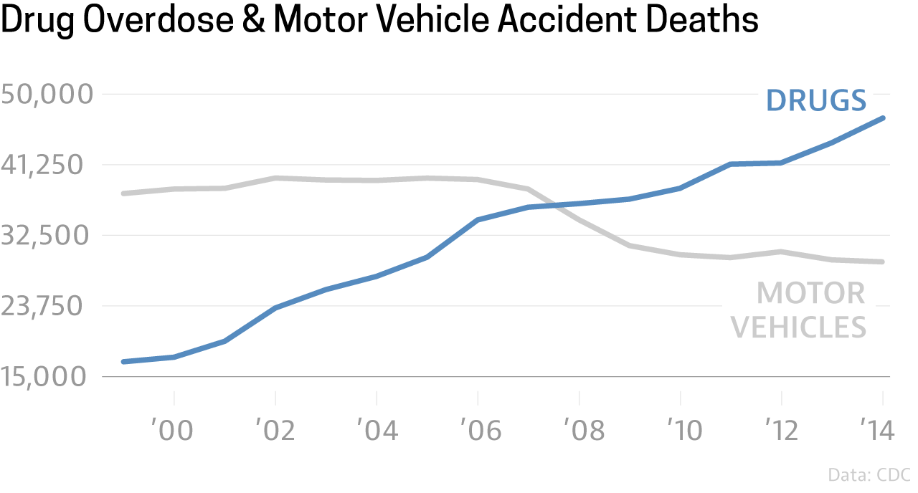
OPIATE EPIDEMIC
Over the last decade, there has been a huge increase in the number of overdose deaths due to opiates!

Slide 3
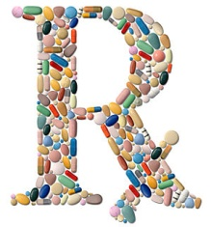
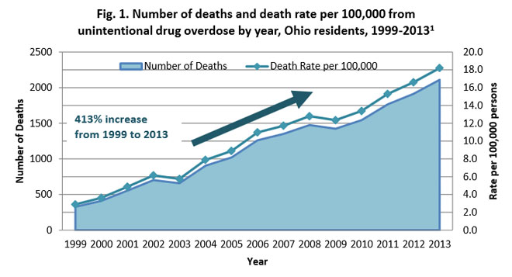
HOW DID WE GET HERE?
Prescribing opiates for pain relief tripled since the 1990’s.
Increase in heroin supply making cheaper alternative to “street” opiates
“Pill-mills”, and unscrupulous doctors prescribing for profit
“Self-medicating” habits
Pharmaceutical marketing to doctors

Slide 4
COSTS OF OPIATE EPIDEMIC
DEATHS: 40 Americans die per day of opiate dependence
Financial: 78.5 Billion Annually
Criminal justice system: costs due to the Drug offenses and offenses to support drug use.
Lost productivity
Grief
Impact to children
Healthcare Costs– Hepatits, HIV, and other medical conditions

Slide 5
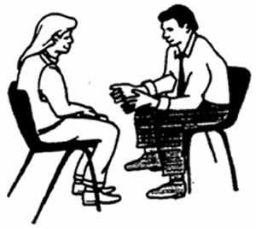
WHAT DO “WE” (gov’t policy) DO ABOUT IT?
Prescriber Education
Opiate Prescribing Guidelines
Eliminating “Pill Mills”
Prescription Drug Monitoring Programs (OARRS)
Increased Access to Naloxone
Increase Access to Substance Disorders Treatment

Slide 6
WHAT CAN WE (treatment providers) DO ABOUT IT?
Detoxification (usually few days)
Inpatient Rehab (usually few weeks)
Residential Placement (maybe months or longer)
Counseling
12-step meetings
Medication --- DATA 2000 (Drug Addiction Treatment Act of 2000

Slide 7
DATA-2000
Federal law passed in year 2000, permits physicians who meet certain qualifications to treat opiate addiction with narcotic medications that have been specifically approved by the FDA for that indication
Allows for Schedule III and below only (buprenorphine, AKA suboxone)
Does not permit methadone
Allows primary care physicians and psychiatrists to prescribe in office-based program

Slide 8
MEDICATION ASSISTED THERAPY -- For opiates
FDA-approved medications for the treatment of Opiate Addiction:
Suboxone (bupenorphine with naloxone)
Methadone (only in designated clinics)
Naltrexone – oral form (Revia) or long-acting injectable (Vivitrol)
Naloxone (for emergency reversal of OD)

Slide 9
BUPRENORPHINE TREATMENT
With DATA-2000 waiver, licensed physician can prescribe, up to 30 patients in first year, and then 100 thereafter. Recently passed regulation allows up to 250.
May be prescribed 30-day supply at time
Patient is seen monthly
Must be engaged in treatment; may be exempted if physician is Addiction Specialized

Slide 10
WHAT CAN “WE” (Coleman) DO ABOUT IT?
Alcohol and Drug Services – including MAT (MEDICATION ASSISTED THERAPY)
Medication Assisted Therapy: Behavioral therapy combined with medication to treat substance abuse disorders
Must be combined with counseling, case management, 12-step meetings, urine tox screens,

Slide 11
Suboxone vs. Vivitrol
Suboxone
Vivitrol
Opiate agonist (is an opiate)
Can be used to treat pain
Controlled substance
Addictive
Potentially abused
High street value
Last about a day
Opiate antagonist
NOT an opiate
Not used to treat pain
Not controlled substance
Injectable form
Lasts one month
Risk of overdose by “override the blockade”

Slide 12
Coleman MAT program – Preworkup
Seen for Diagnostic Assessment, meets criteria for Opiate Dependence and Axis I mental health disorder
Referrals (counseling, case management, psychiatry, groups)
Physical Exam
Obtain records
Laboratory workup
Urine toxicology screen
Informed consent
Consent to daily dosing
Agree to individual and group AoD counseling
Agree to three 12-step meetings/week, provide evidence
Seen by Physician to prescribe
Preauthorization for insurance
Induction on the CSU

Slide 13
Medication-Assisted Treatment – Coleman
Barriers
payor source issues,
medical problems,
relapse,
legal issues,
individual motivation,
transportation,
childcare,
daily dosing conflicts (work),
other substance use,
poor compliance

Slide 14
Catch me for questions!

