Slide 1
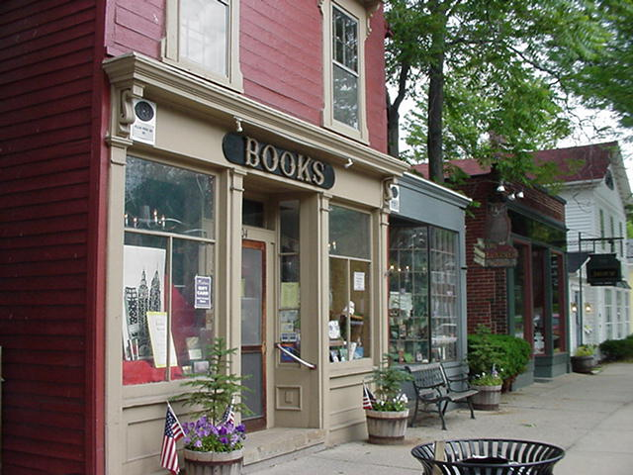
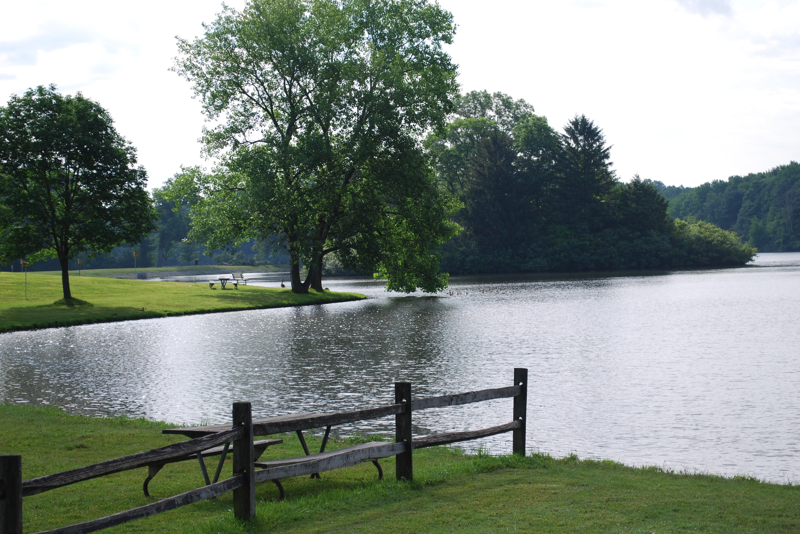
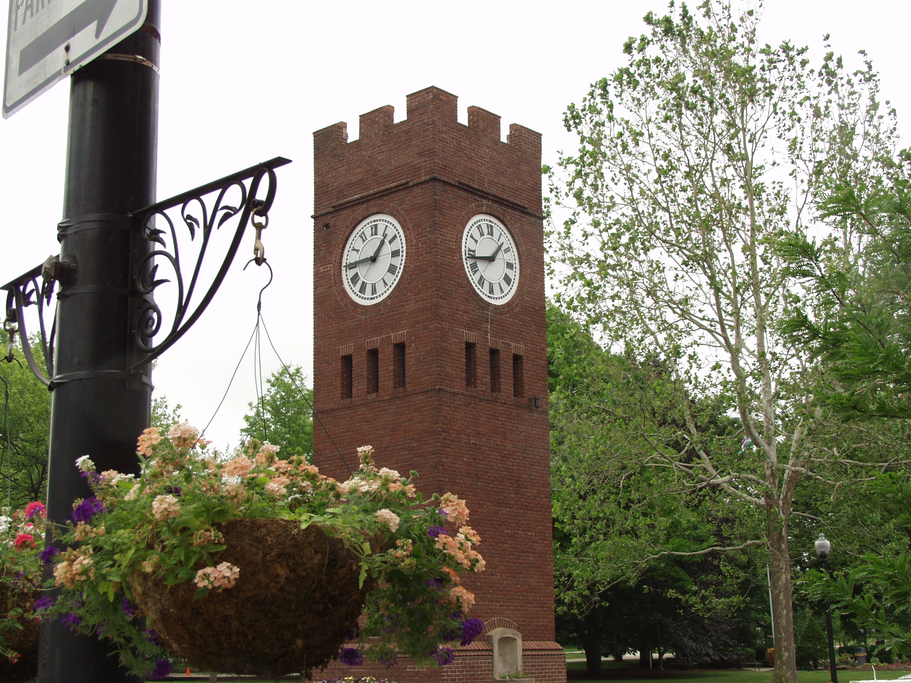
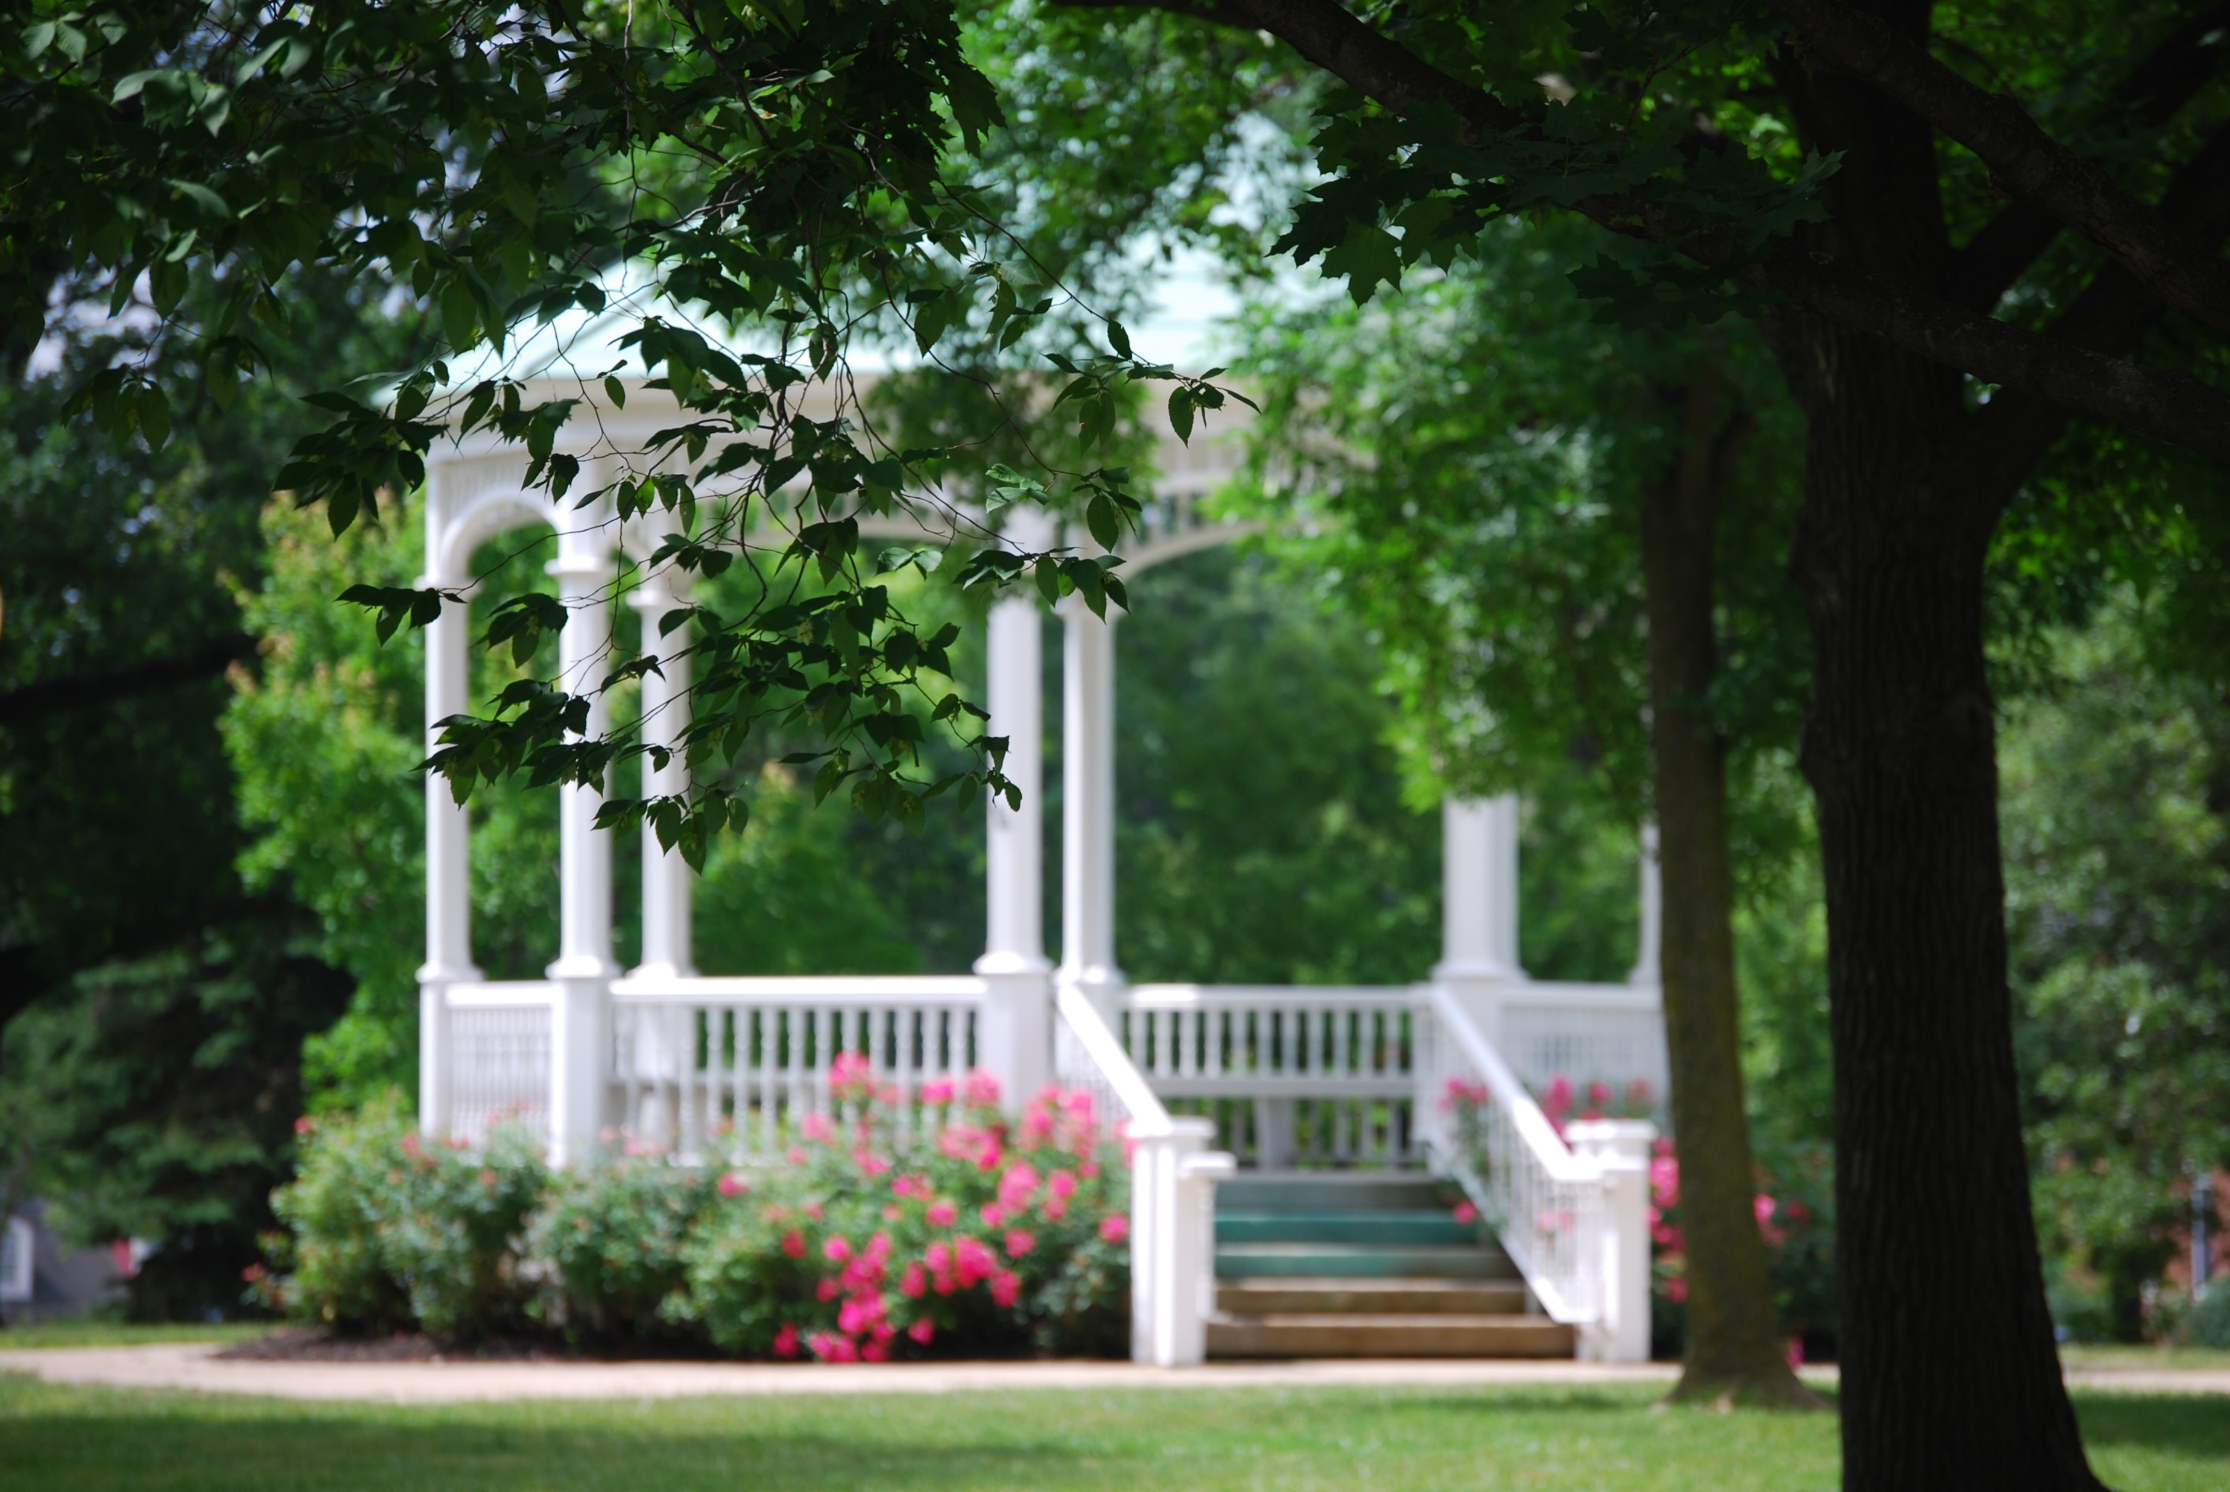

Slide 2
2017 Trends Report
“ADDICTION IS THE NEW CANCER”
http://www.franklinstreet.com/
“The Surgeon General’s report on addiction is a
call to arms to every health system in the nation”
20 million Americans battle addiction
Injuries from drug overdose is the leading cause of injury death in the U.S., ahead of motor vehicle deaths and firearms
Heroin epidemic is shattering records as it decimates whole generations
Surgeon General has identified addiction as “a bigger health problem than cancer”
It’s in our cities, our suburbs, our farms and our living rooms
This fight is here. Get ready!

Slide 3
Addiction is a Disease of Adolescence
Age of First Drug Use
13 & younger
14
15
16
17
18
19
20
Percent with Lifetime Drug Use
33.6%
26.8%
25.4%
17.7%
15.1%
15.0%
13.4%
11.4%

Slide 4
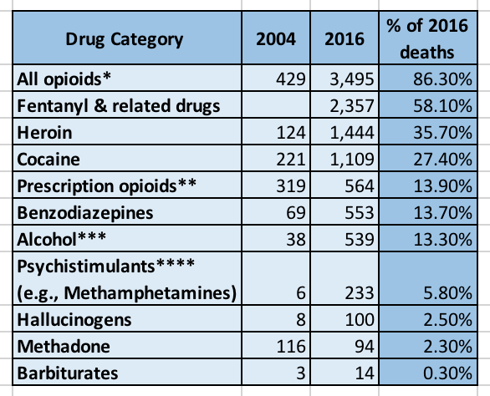
Table 1. Number of Unintentional Drug Overdose Deaths Involving Specific Drug(s), As Mentioned on Death Certificate, by Year, 2004-2016 ¹⁻³

Slide 5
HOW DID HUDSON GET HERE?

Slide 6
2017
Observations from Hudson Conversations

Slide 7
Hosts
Hudson Community Foundation
Hudson City Schools
Hudson Community First
Hudson Library & Historical Society
Prosecutor Sherri Bevan Walsh
Day Ketterer
Cover2 Resources
The Community of St. John
Summit County Developmental Disabilities Board
North Summit Rotary Cluster
Restore Addiction Recovery/The Dalton Foundation

Slide 8
Participants
Approximately 150
Age range high school to mid 70s
90% live or work in Hudson

Slide 9
What brought you to the table?
Parents of addict/family member with drug or alcohol issues
Church employee wants to help members
Passion for others promoting drug free culture
Wants to know what the issues are – increase personal awareness
Have children and want to know the “real” story
Educators concerned for students
Public service employees want to engage with community

Slide 10
What is your perception of the drug & alcohol issues in Hudson?
Heavy alcohol/marijuana use
The “normalization” of marijuana use
Parents don’t always demonstrate responsible use
Parents allow kids to drink at their house
Kids are under pressure – Xanax, Adderall, Ritalin are bought & sold
Prescription drug use by adults
Opiate issue is not as widespread as other communities
“A big problem” but residents aren’t willing to admit it or talk about it
Most conversations shifted to kids

Slide 11
How did we get here/what is the root cause of the problem?
Peer pressure to be cool
Loneliness/depression/helplessness
Easy access & adequate financial resources to buy
Over prescribing of pain medication by physicians
Addiction is hereditary & a disease (1/10 people are predisposed)
Casual usage can quickly escalate with certain individuals
Parents enable
Kids self medicating to perform higher and relieve stress
Mental health & addiction often go hand in hand
Internet/cell phones/social media play a role

Slide 12
Would you know where to go for help if you were faced with a problem?
A resounding “NO”
Would check the internet
EMS
Help is not personalized enough for kids to feel they have a trusted individual at schools; kids don’t have a strong relationship with their guidance counselors
People want to go outside of Hudson – keeping up with the “White Picket Fence”
People often wait until crises to get help and then it is difficult to navigate the process

Slide 13
What’s the Solution?

Slide 15
GET HELP
GET ENGAGED
GET EDUCATED

Slide 16
GET HELP
How can people get help if they don’t know who to call or where to go?
Hudson Drug and Alcohol Community Resource Specialist position developed

Slide 17
Hudson Drug and Alcohol Community Resource Specialist
Establish positive and sustainable relationships with various community organizations in order to better assist those living, working and going to school in Hudson with confidential drug and alcohol resource information
Developed a communication plan
330-822 HELP (4357)
DrugSafeHudson.org
Social Media Platforms i.e. Facebook, Twitter

Slide 18
What can I do?

Slide 19
GET ENGAGED
Drug Safe Hudson CAN’T do this alone
We need YOUR help!
SHARE about Drug Safe Hudson’s mission: Provide confidential resource info
TELL your family and friends
FOLLOW us on Twitter and Facebook
LIKE our Drug Safe Hudson face book page
Check out our WEBSITE: https://DrugSafeHudson.org

Slide 20
GET EDUCATED
The City of Hudson has seen a dramatic increase of reported overdoses
In two short years, the number of overdose cases in Hudson has almost doubled
2016: 14 overdose cases, Narcan used 4 times
2017: 27 overdose cases, Narcan used 19 times

Slide 21
Who is being helped?

Slide 22
Meet the “Hudson” family

Slide 23
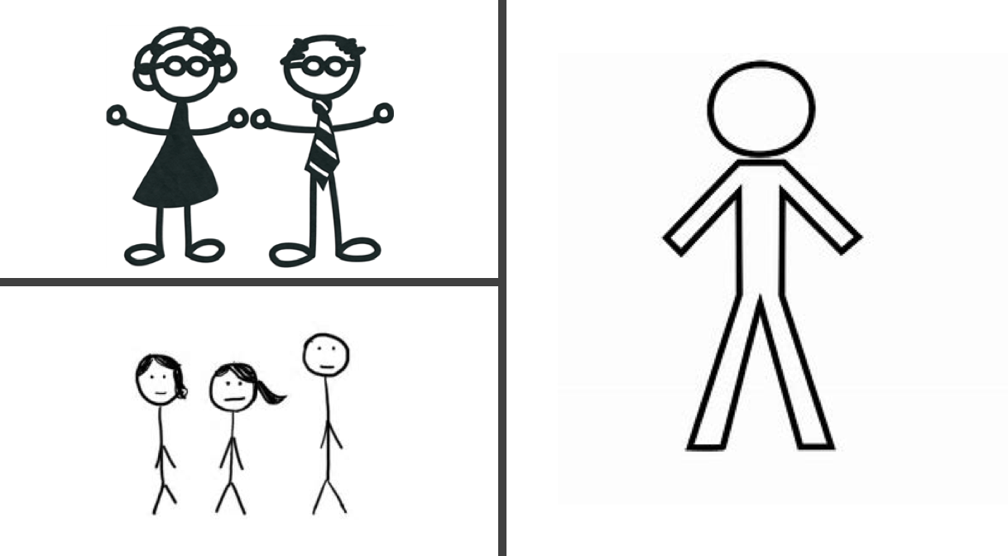

Slide 24
In Recovery: Much to Manage
Continuum of Care
Detox
Intensive Inpatient
Medication Assisted Treatment
IOP
Primary Care
Residential
Aftercare Counseling
Transitional Housing
Employment Services
Permanent Housing
Transition to Primary Care Management
Critical Life Areas
Living Arrangements
Prior Addiction Treatment History
Social Environment
Legal Involvement
Family History and Support
Education
Current or Prior Mental Health
Employment
Treatment or Conditions
Victimization History and Issues
Medical Status and Conditions

Slide 25
In Recovery: A Team Makes All the Difference
Inpatient Treatment Specialists
Sponsor
Community Housing Support
Detox Specialist
Peers
12 step
Coach
IOP Specialists
Individual Counselor
Group Counselor
Family
Spiritual Guide

Slide 26
Questions?

